Slide 1

Team Members Vinayak chougule Mahesh Dnyaneshwar Haldankar Sagar Sankadal
PRESENTED BY GROUP 3

Slide 2
agenda
INTRODUCTION 3
OVERVIEW 4
PROJECT ANALYSIS 5
RECOMMENDATIONS 9
CONCLUSION 10

Slide 3

Introduction
Adventure Works Analytics Project – End-to-End Data Analysis
This project focuses on analyzing Adventure Works sales data to derive meaningful business insights using multiple data analytics tools. The dataset contains information related to sales transactions, products, customers, categories, regions, and time-based attributes.
The main objective of this project is to understand sales performance, customer behavior, product trends, and profitability by performing data cleaning, transformation, analysis, and visualization across different platforms.
To demonstrate a complete data analytics workflow, this project is implemented using four modules: Excel, SQL, Power BI, and Tableau.
This Photo by Unknown Author is licensed under CC BY

Slide 4
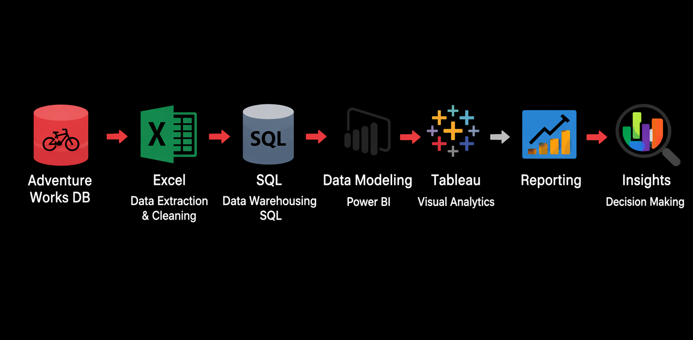
Project Overview :
Analyzed Adventure Works sales data to uncover insights about:
Sales distribution across years and regions
Product category and subcategory performance
Customer purchasing behavior
Profitability and cost analysis
Followed an end-to-end data analytics lifecycle including data cleaning, transformation, analysis, and visualization
Used multiple tools to showcase versatility and practical data analytics skills
Built interactive dashboards and KPIs for clear and effective business storytelling
Tools Used :
Excel – Data cleaning, transformation, and initial sales analysis
SQL (MySQL)– Data storage, joins, calculations, and analytical querying
Power BI – Interactive dashboards, KPI cards, and trend analysis
Tableau – Advanced visual analytics and storytelling dashboards

Slide 5
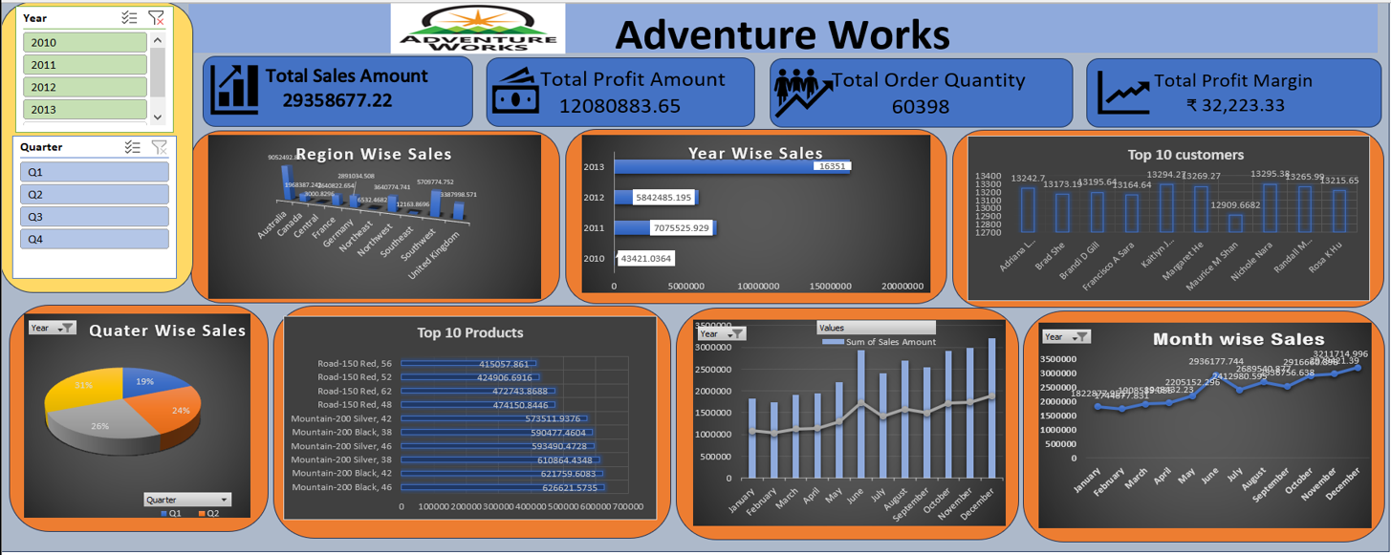
Excel dashboard
✅What We Did:
Cleaned and structured raw sales data
Created calculated columns (Sales, Profit, Cost)
Built Pivot Tables
Designed KPI dashboard
📈INSIGHTS
Sales peak in Q4
Bikes contribute highest revenue
USA & Australia lead in sales
Profit depends on cost efficiency

Slide 6
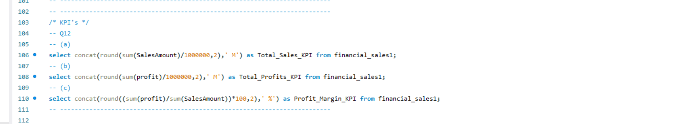
SQL KPIS

Slide 7
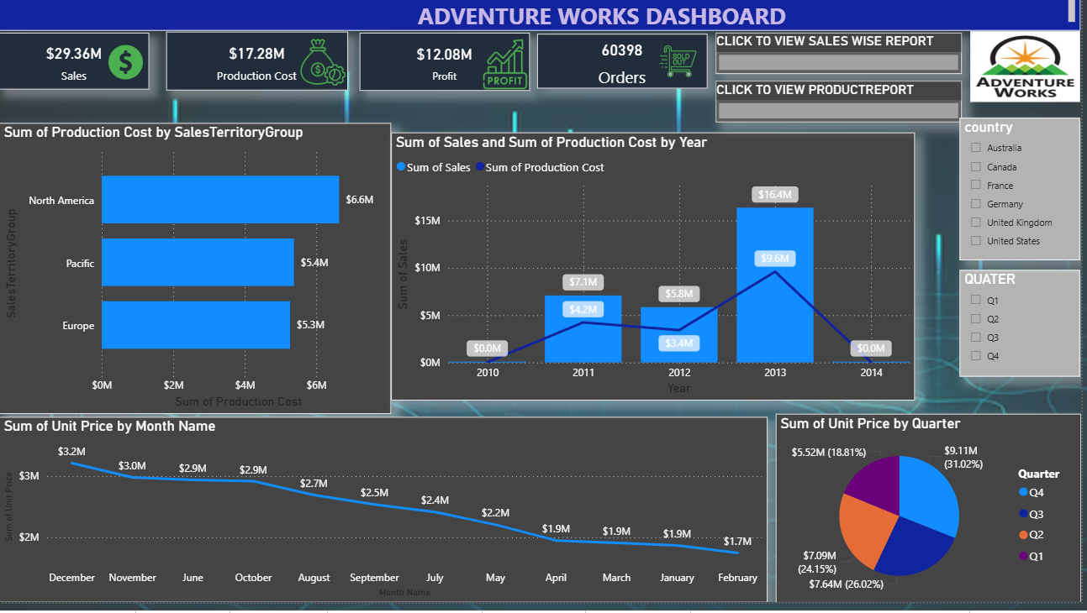
Power bi Dashboard
✅What We Did :
📈Insights :
Consistent year-wise growth trend
Clear seasonal pattern in monthly sales
Production cost significantly impacts profit margin
Top 10 products contribute major share of revenue
Regional performance varies significantly
Imported and transformed data using Power Query
Created relationships between fact and dimension tables
Built DAX measures (Total Sales, Profit, Margin %)
Designed interactive visuals with slicers
Developed dynamic KPI cards

Slide 8
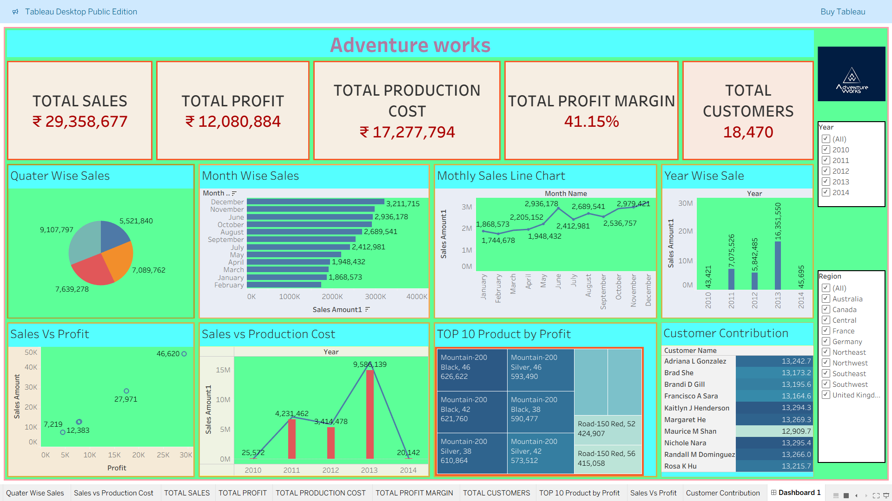
Tableau Dashboard
✅What We Did :
Connected structured dataset to Tableau
Created calculated fields and parameters
Designed Year-wise, Month-wise and Quarter-wise visuals
Built Profit Margin and Customer KPIs
Developed interactive drill-down analysis
📈Insights :
2013 recorded highest annual sales
Q4 shows strongest sales performance
Top customers contribute large portion of revenue
Sales growth does not always translate to higher margins
Cost optimization improves overall profitability.

Slide 9

Increase focus on high-selling and high-profit products
Optimize pricing and discount strategies to improve margins
Improve inventory availability for high-demand products
Strengthen sales performance in high-revenue regions
Target repeat customers with loyalty and promotional offers
Expand marketing efforts for underperforming product categories

Slide 10
Conclusion
The Adventure Works dataset was analyzed using Excel, SQL, Power BI, and Tableau
Data was cleaned, transformed, analyzed, and visualized to extract meaningful business insights
KPIs and dashboards helped understand sales performance, profitability, and customer behavior
This project demonstrates a complete end-to-end data analytics process
The insights generated can support better business and strategic decision-making

Slide 11

thank you
BRITA TAMM
502-555-0152
brita@firstupconsultants.com
www.firstupconsultants.com

